Slide 1
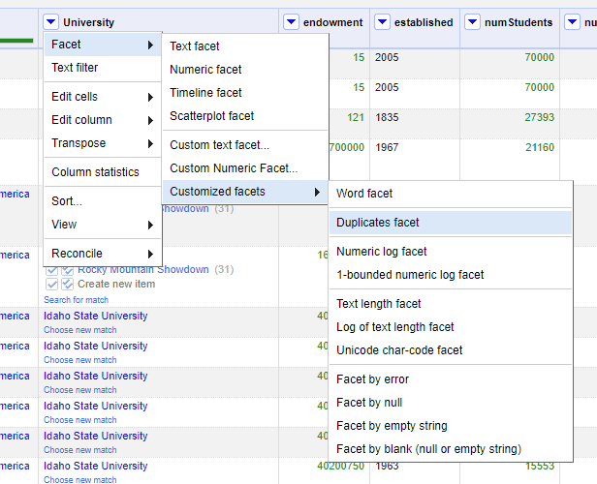
Geocoding names and addresses
This part shows how to go from a description of a place (that is, the name of a university) to the values of its (probably) geographic coordinates.
Behind the scenes, this uses Google Maps, you do not need to process the entire data set. This may take a while. We will create a Customized Facets -> Duplicates Faced on the University column.

Slide 2
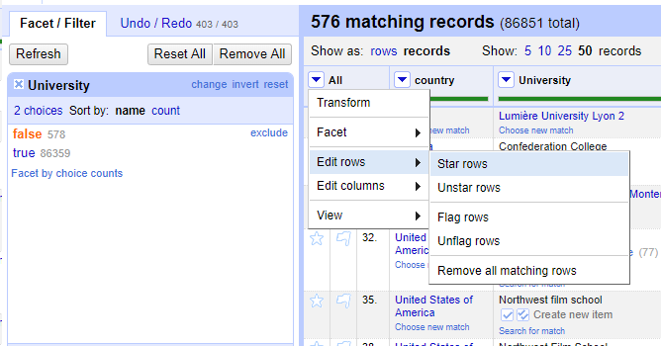
Geocoding names and addresses
We will select the Sub filter False to mark the records with a star Edit rows -> Star rows on the column All.

Slide 3
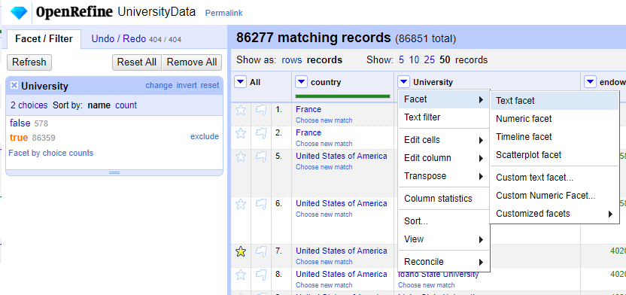
Geocoding names and addresses
●
We will select the True Sub filter to mark the records with a star, for this we will make a text facet on the University column,
Facet -> Text Facet

Slide 4
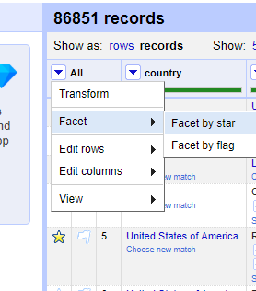
Geocoding names and addresses
●
To make a more selective filter of the data to search, we will do a facet by Star on the All column. Facet -> Facet by star

Slide 5
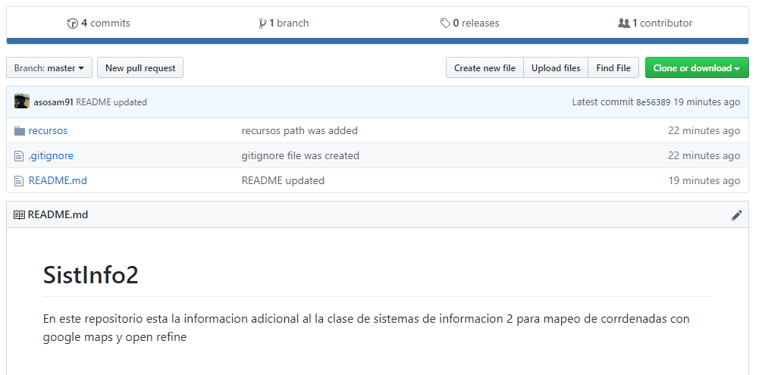
Geocoding names and addresses
●
Now we need to clone the following git repository.
https://github.com/asosam91/SistInfo2
●

Slide 6
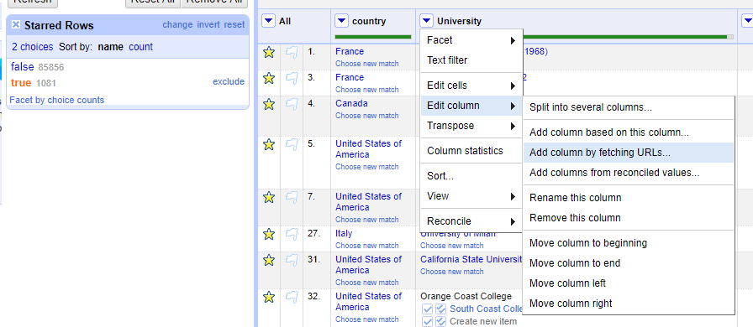
Geocoding names and addresses
●
We want to do Edit column -> Add column by fetching URLs. In other words, the values of the cells in the new column are based on data that is retrieved from the Internet.

Slide 7
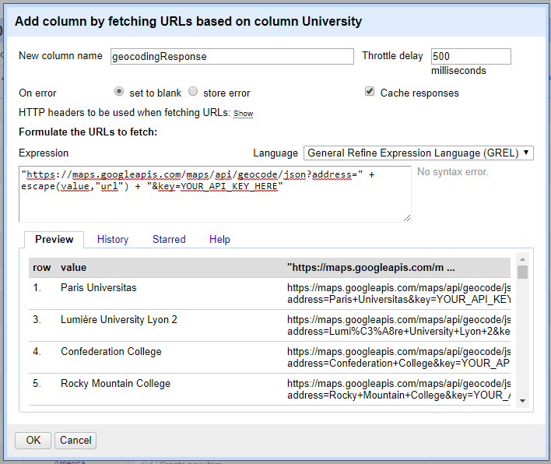
Geocoding names and addresses

Slide 8
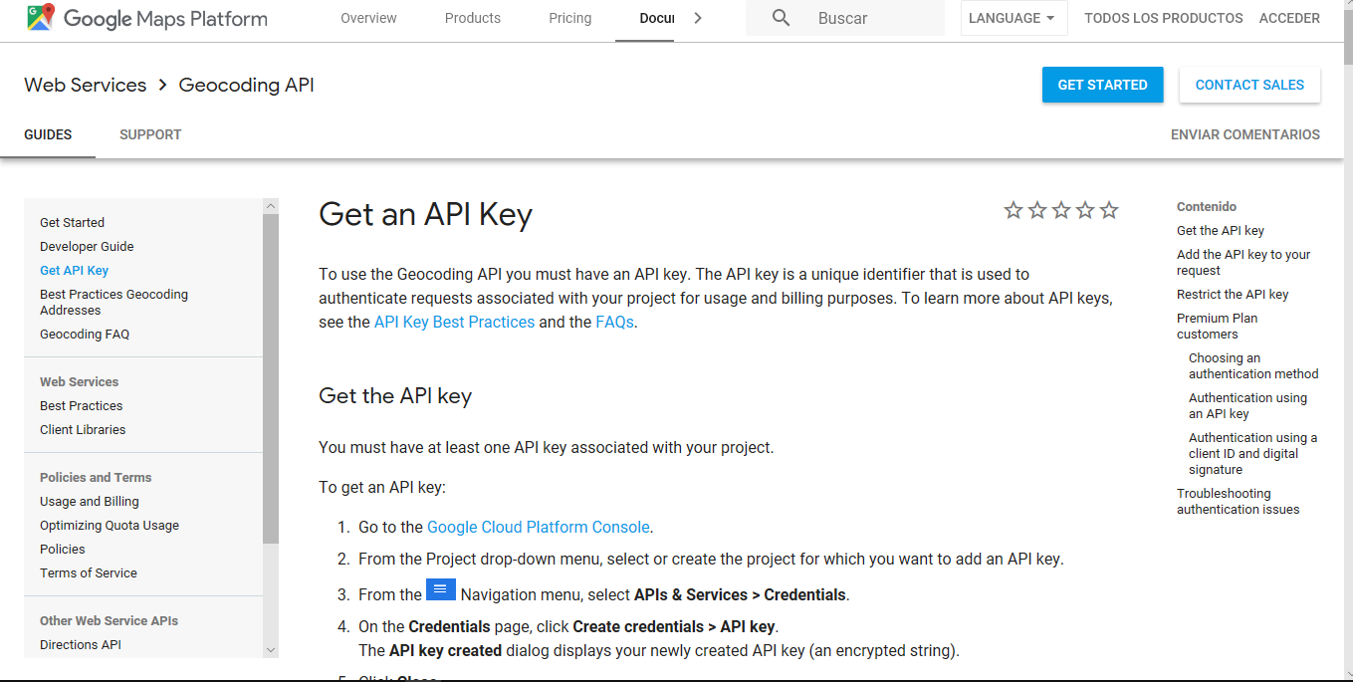
Geocoding names and addresses

Slide 9
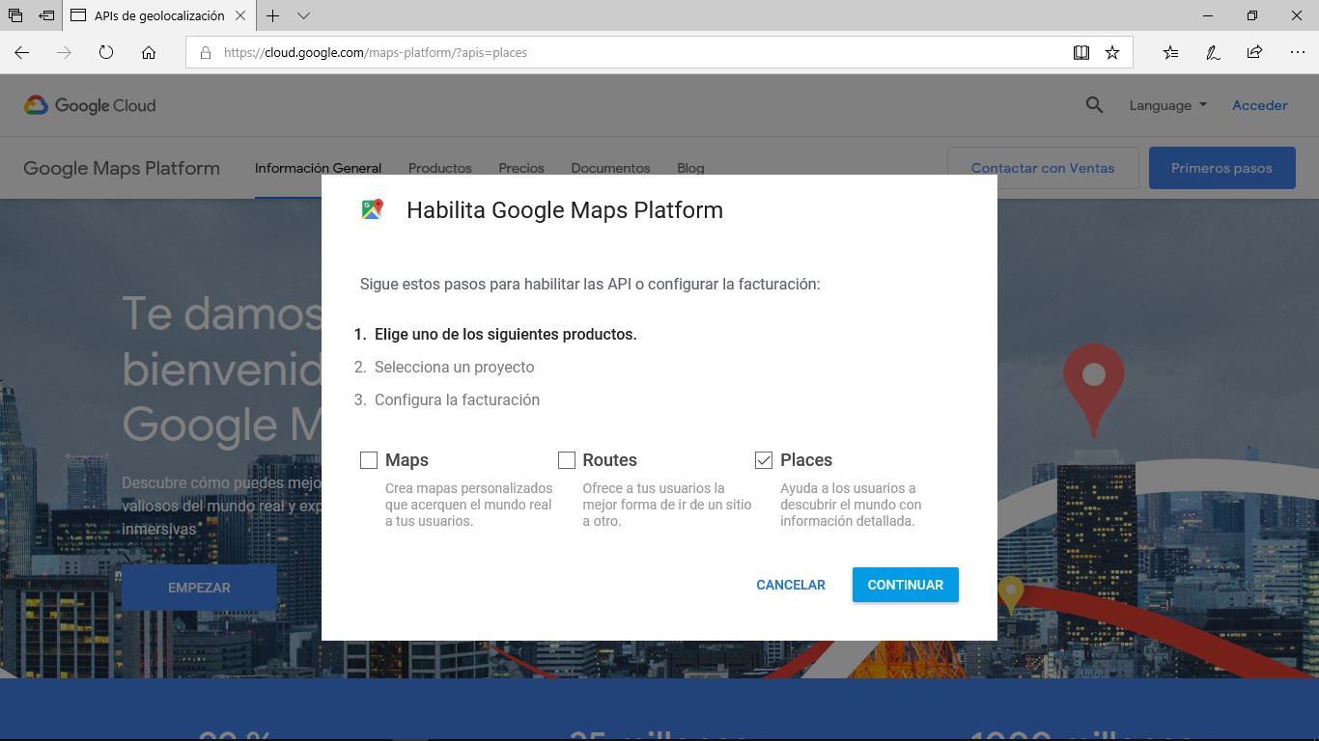
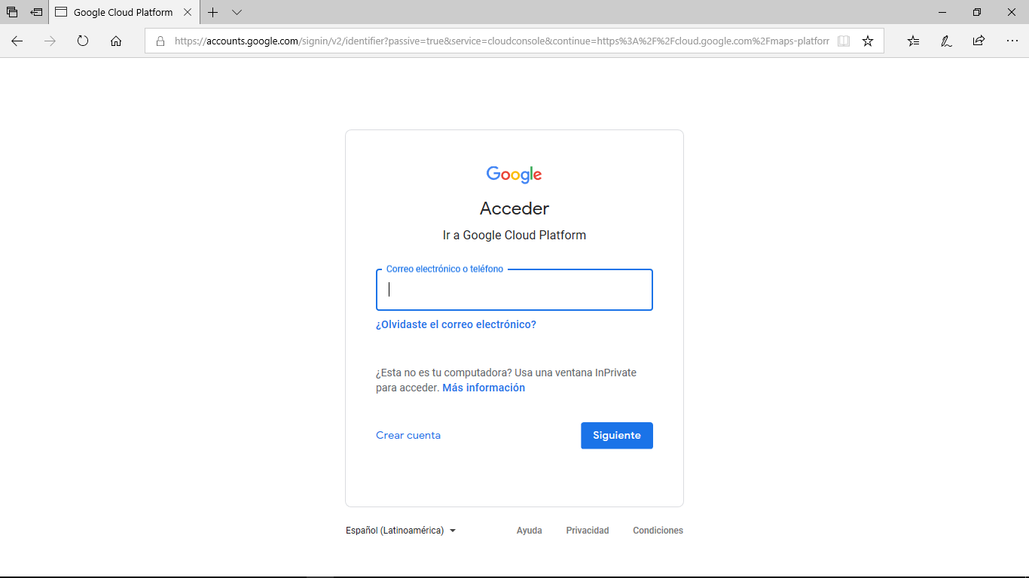
Geocoding names and addresses

Slide 10
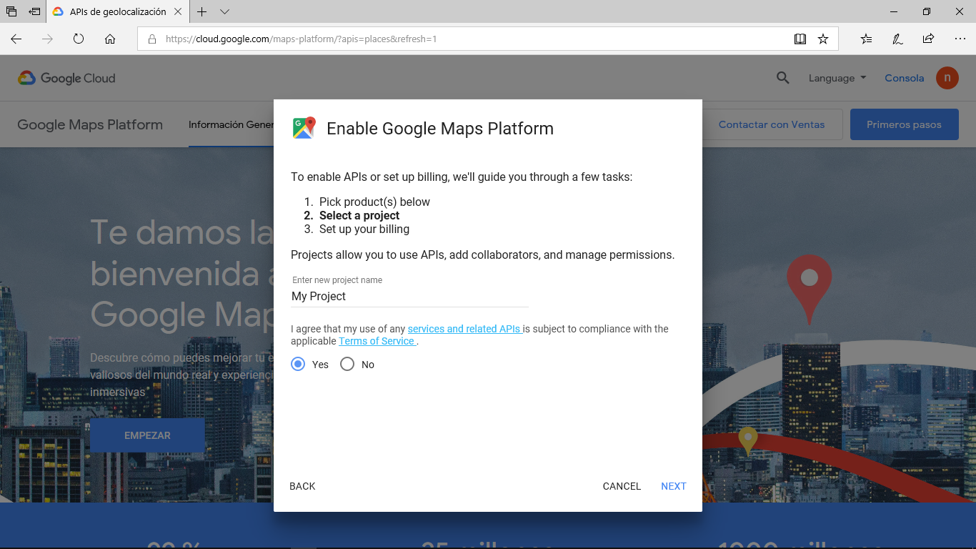
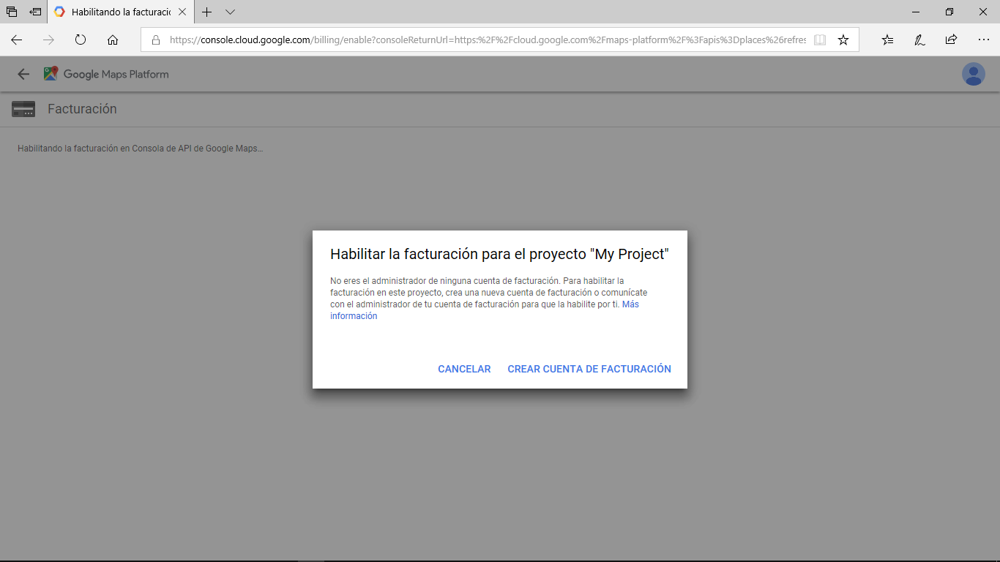
Geocoding names and addresses

Slide 11
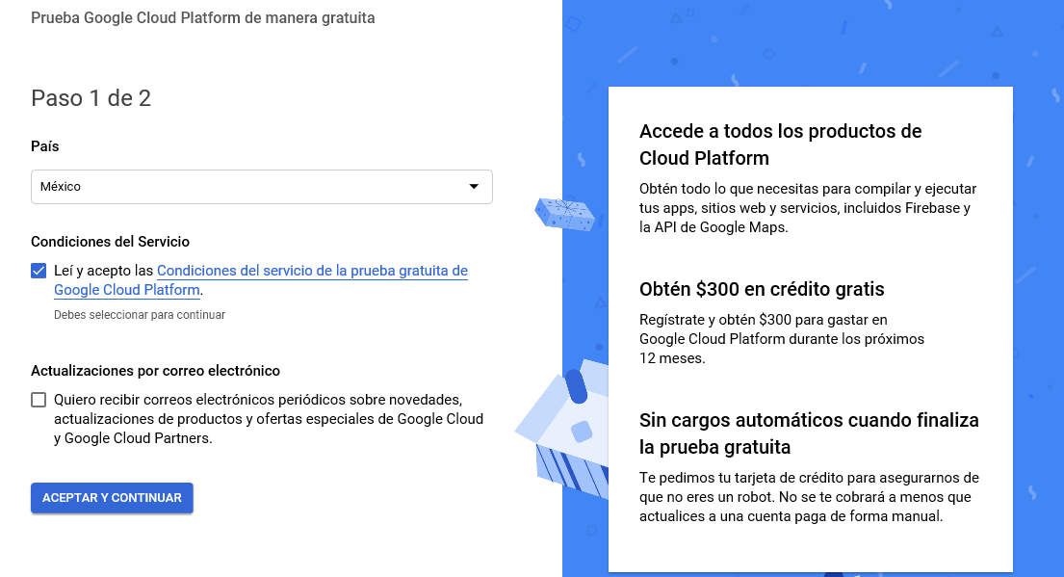
Geocoding names and addresses

Slide 12
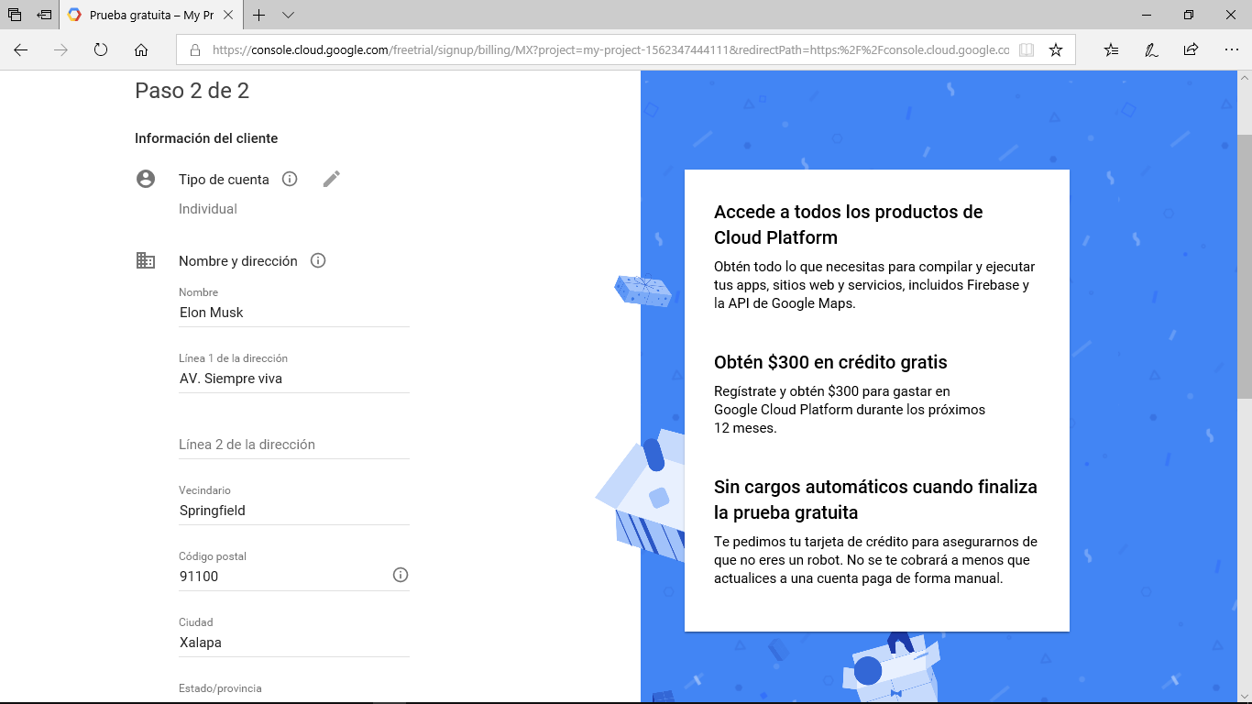
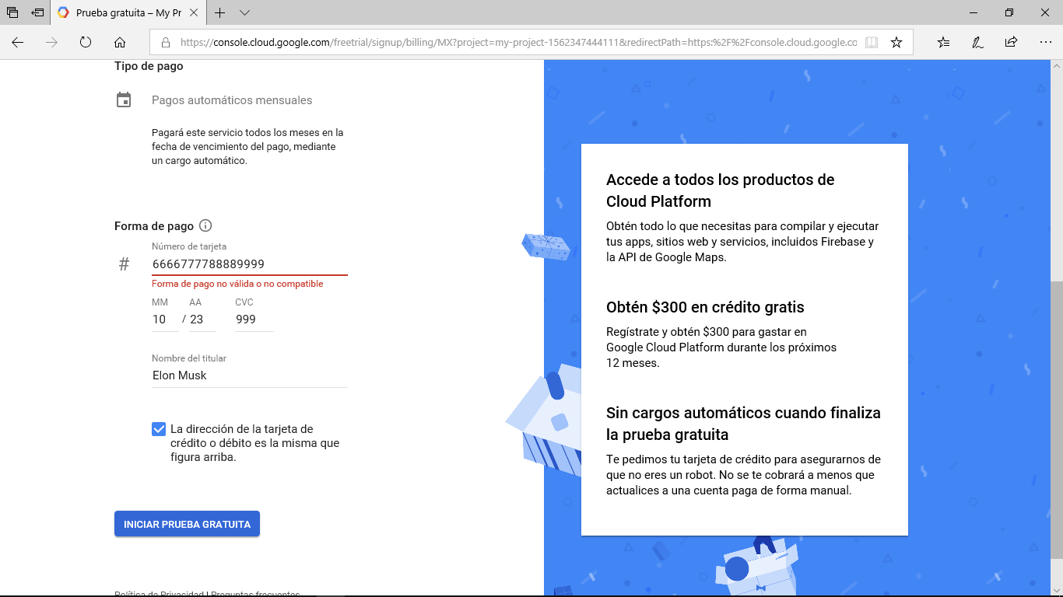
Geocoding names and addresses

Slide 13
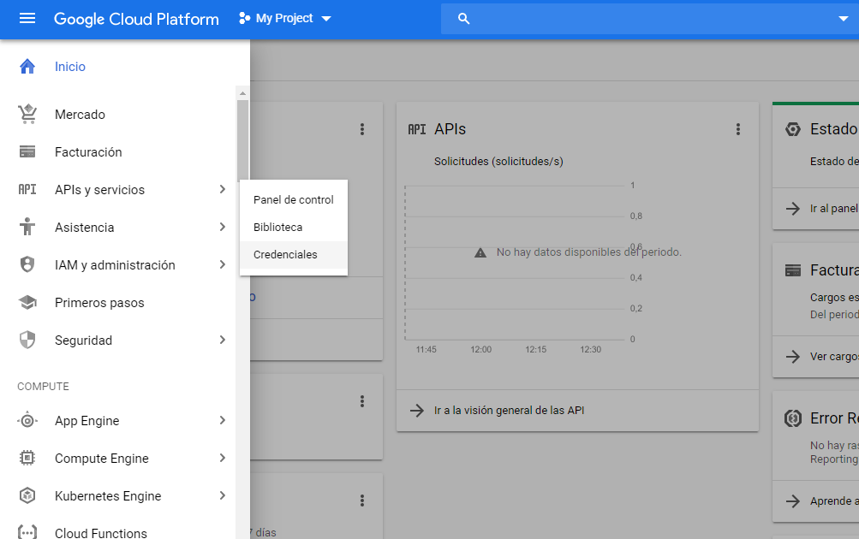
Geocoding names and addresses

Slide 14
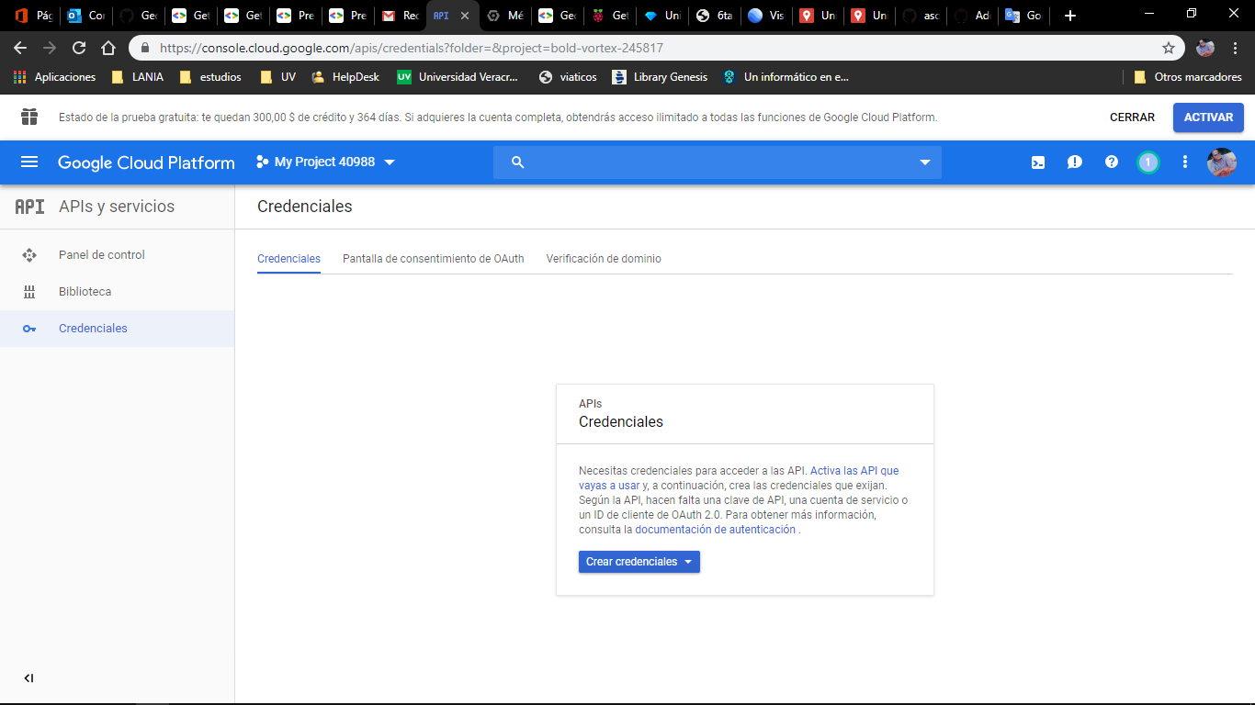
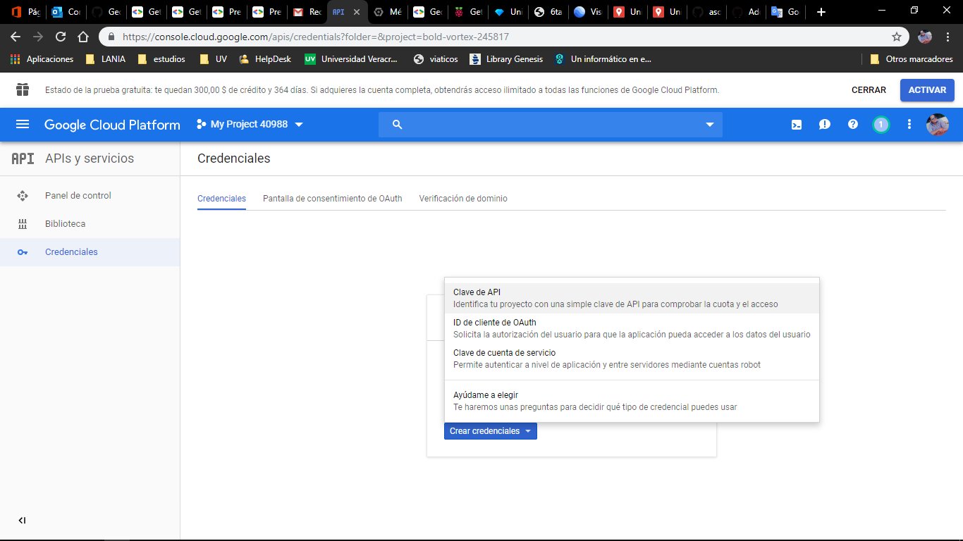
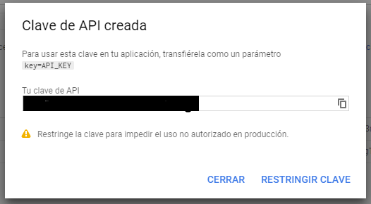
Geocoding names and addresses

Slide 15
Geocoding names and addresses

Slide 16
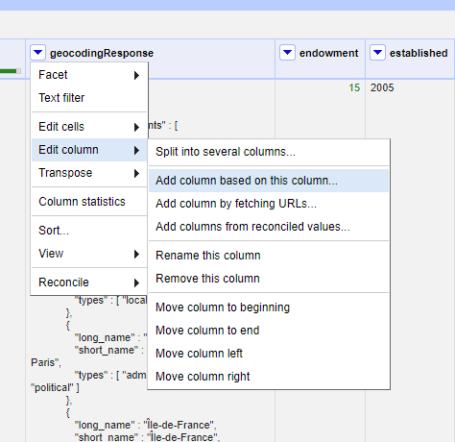
Geocoding names and addresses
we will create a new column from geocodingResponse.
Edit column -> Add column based on this column

Slide 17
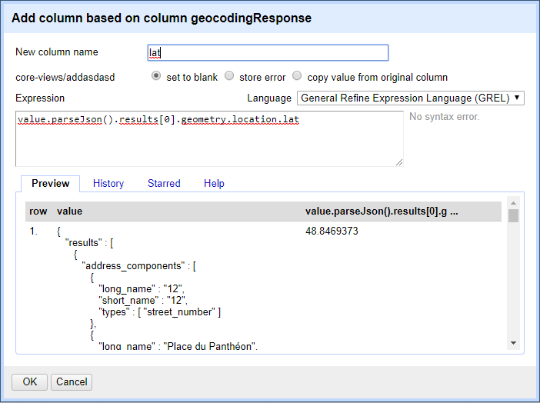
Geocoding names and addresses

Slide 18
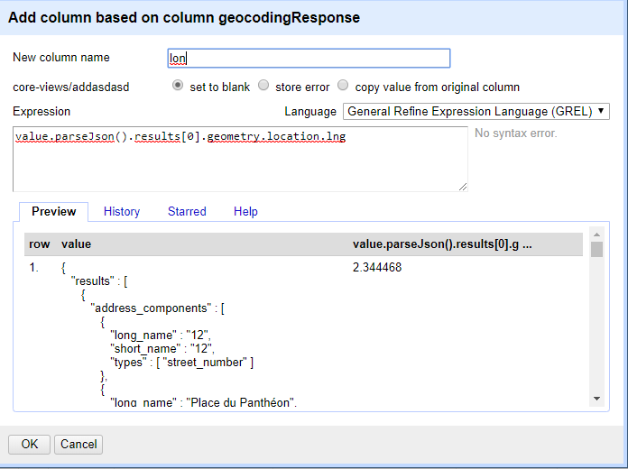
Geocoding names and addresses

Slide 19
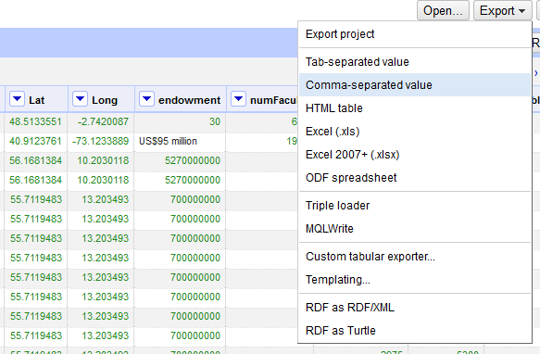
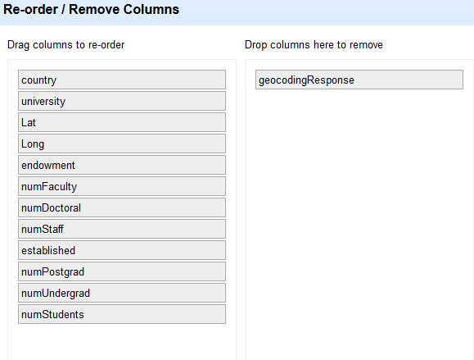
Mapping
●
Once we have collected approx 300 records with its respective coordinates (lat,long). We need to export this dataset into a .csv file

Slide 20
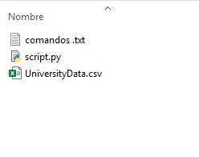
Mapping (Optional)
we copy the downloaded file to the resources folder and execute the script there content

Slide 21
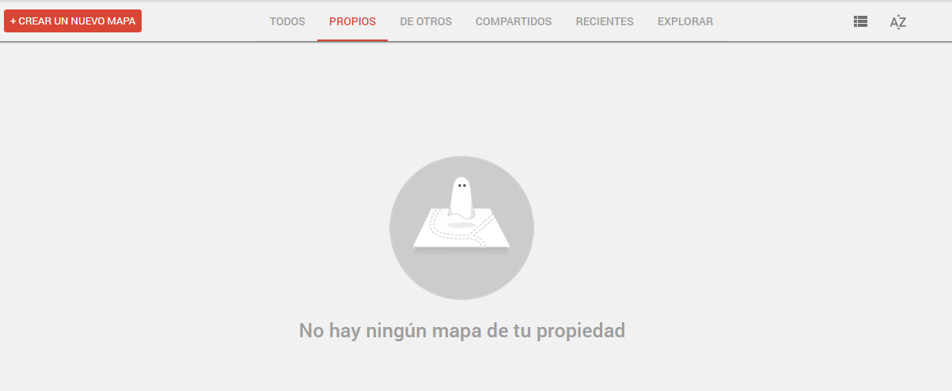
Mapping
●
we access the url provided for mapping with our google account.
https://www.google.com/mymaps
And start a new map

Slide 22
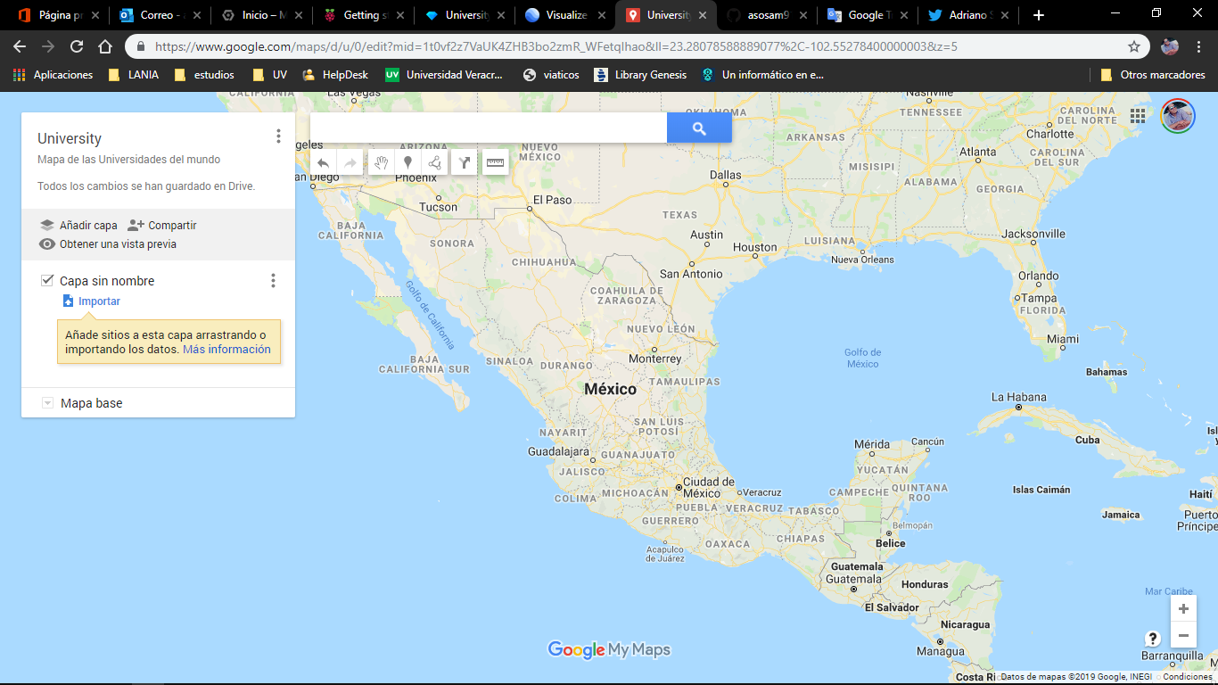
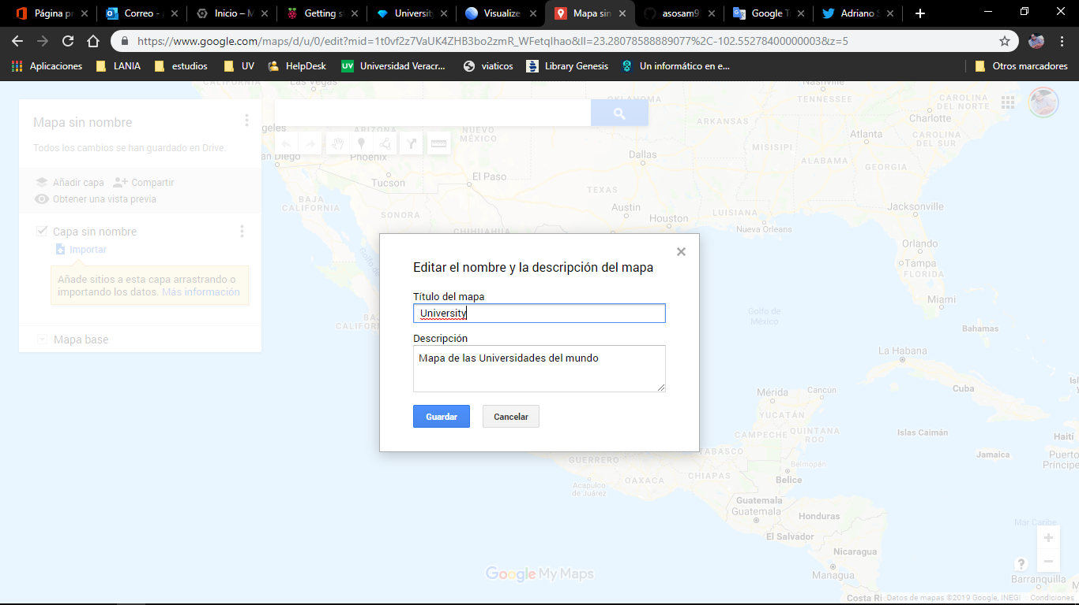
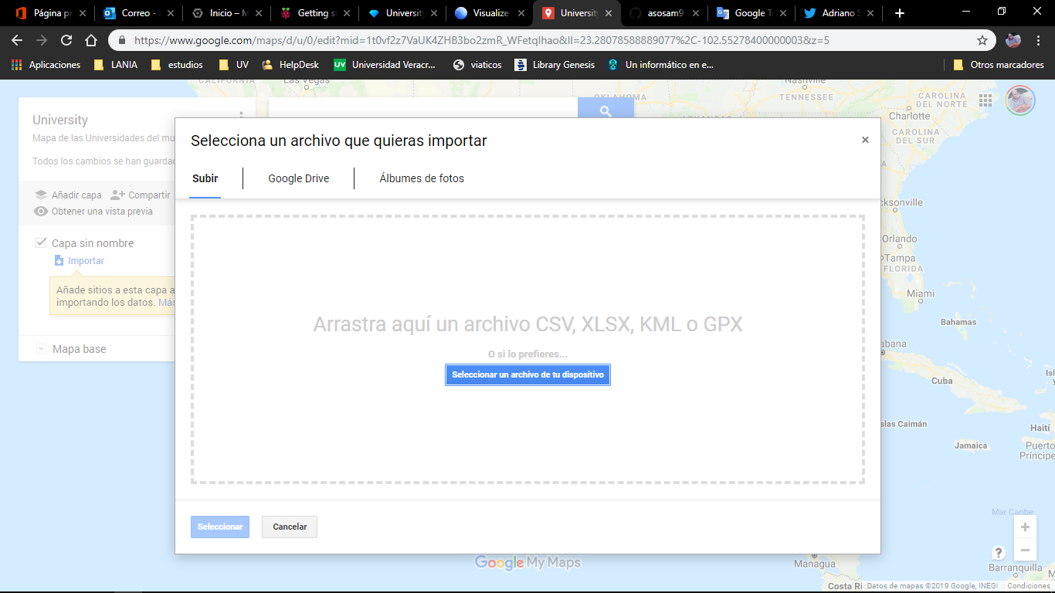
Mapping

Slide 23
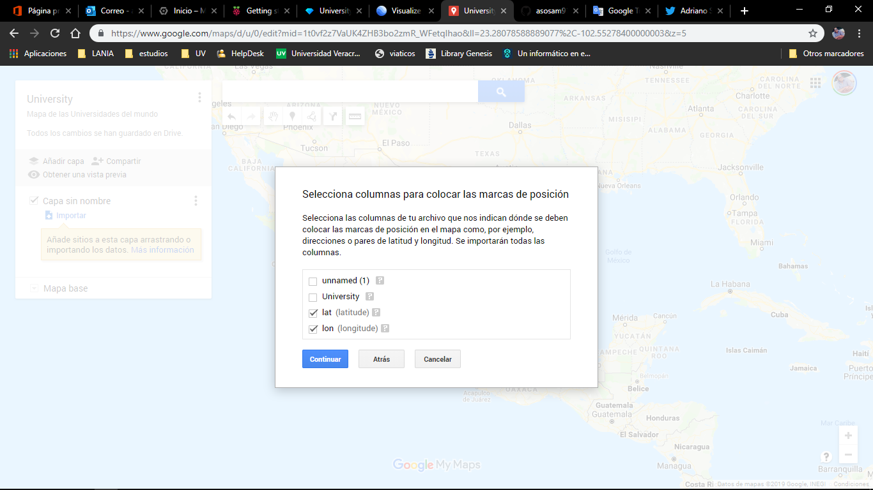
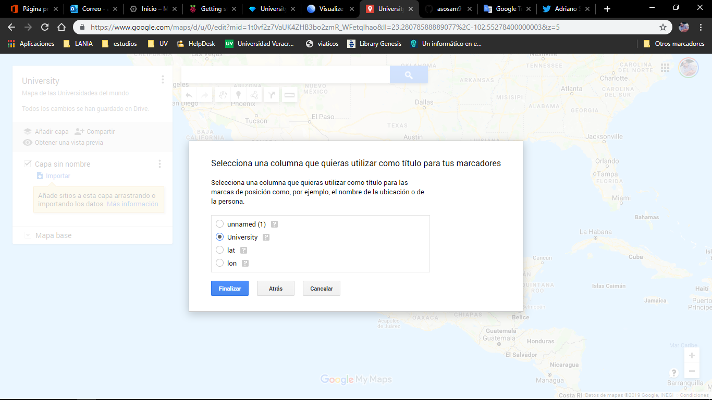
Mapping

Slide 24
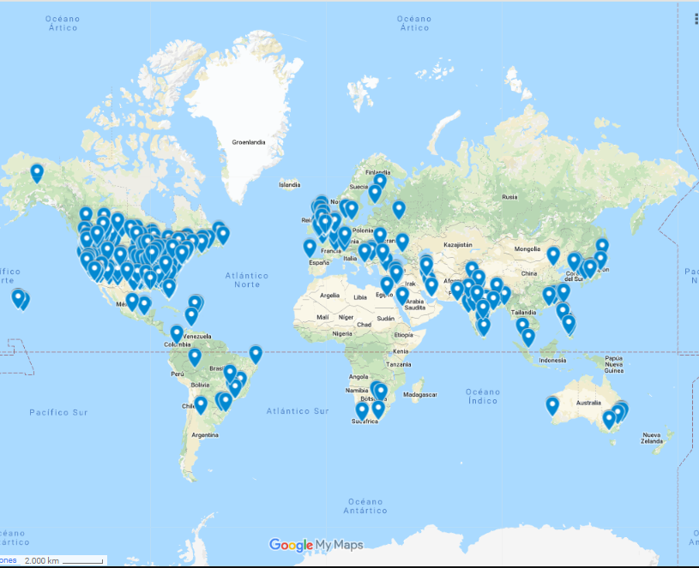
Mapping

